Slide 1
Data and Algorithm 15
Chulalongkorn University
School of Integrated Innovation
Fall 2023
Marko Niinimaki Marko.N@chula.ac.th

Slide 2
Where are we?
15 | 21 Nov | Summary (no class)
Please check the Exam Instructions document in Class Material (Teams).

Slide 3
Main topics for the final exam
Bits, bytes and files
Sort/find algorithms and the Big O notation
Databases and database management systems
Basic web technologies: HTML and HTTP
Relational databases and the relational model
SQL
noSQL databases
Blockchains, hash functions and hash tables
Linked lists
JSON and APIs
Cloud computing and Cloud service models
Text databases
Cloud platforms like Python Anywhere
Stacks, queues and heaps
Big Data

Slide 4

The digital world
1 byte, 8 bits, range 0..255, typically stores 1 character (except e.g. Thai script)
1 kilobyte, 1000 (or 1024) bytes, about 1 page of text in English
This image is about 200 kilobytes.
1 megabyte, 1000 (or 1024) kilobytes. A typical mobile phone camera image is 2 or 3 megabytes.
1 gigabyte, 1000 (or 1024) megabytes. A short film (today’s normal resolutions) or a TV series episode. A browser like Google Chrome ~ 1 GB.
Notes:
https://data.commoncrawl.org/crawl-data/CC-MAIN-2023-40/index.html ~100 TB compressed. May be about 1 PB uncompressed.

Slide 5
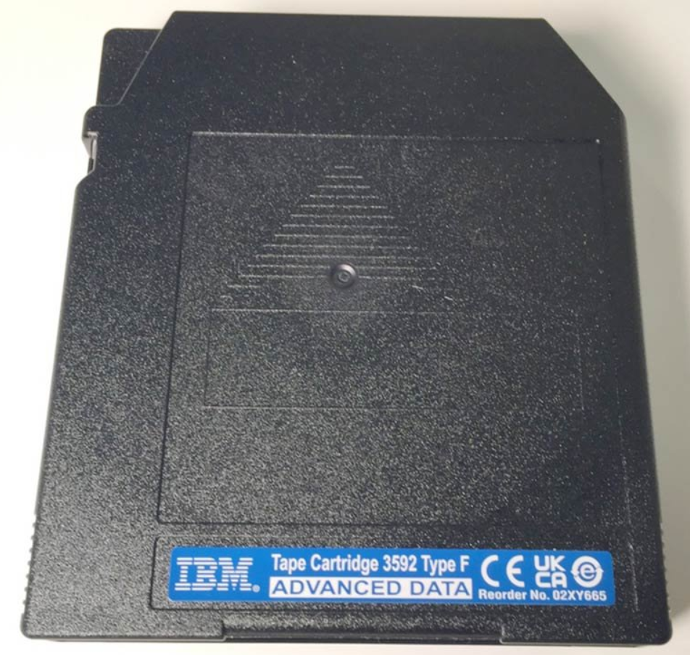
Bytes once again
1 terabyte, 1000 (or 1024) gigabytes. The capacity of a typical laptop disk.
1 petabyte, 1000 (or 1024) terabytes. CERN stores about 1 petabyte of physics data per year [on disks and tapes].
1 exabyte, 1000 (or 1024) petabytes.
1 zettabyte, 1000 (or 1024) exabytes. We create about
120 zettabytes each year. Much of that is by IoT.
https://data.commoncrawl.org/crawl-data/CC-MAIN-2023-40/index.html ~100 TB compressed. May be about 1 PB uncompressed
https://explodingtopics.com/blog/data-generated-per-day
The tape cartridge in the picture ~ 150 terabytes.

Slide 6
Who has the data?
Individuals? Documents, photos, music, videos and (oddly) games. Some gigabytes to terabytes.
The average company manages 162.9TB of data, the average enterprise has 347.56TB of data, seven times as much data as the average SMB with 47.81TB.
IDG Data Analytics Survey 2016.
Big tech companies: Petabytes.
Governments? A lot.
https://www.zdnet.com/article/us-government-has-12166-data-centers-and-most-of-them-inefficient-can-hybrid-save-the-day/ (2019)

Slide 7
Where is it: Files.
In files, for example Excel spreadsheets, word processor documents, slides like these, simple text files, Python (and other programming language) source code files, PDFs, photographs, videos etc.
Example: The Enron corporation collapsed around 2001 and much of its data is available for research. https://www.researchgate.net/publication/304552688_Enron's_Spreadsheets_and_Related_Emails_A_Dataset_and_Analysis The researchers studied ~ 16 000 Excel files, average size ~113 kilobytes, the largest 41 MB.

Slide 8
Where is it: Databases.
Relational databases like MySQL. Very popular, the SQL query language is very well known and the queries execute quickly if the data is well organized. Require a strict schema (tables).
NoSQL databases. Most noSQL databases do not require a strict schema, data items can vary according to the user’s needs.
Examples: Estimated 810 million websites run the WordPress content management system (https://scii.chula.ac.th does, too). WordPress stores its data in MySQL/Mariadb.
MongoDB is a popular document database (noSQL).

Slide 9
Where is it: In the web
The World Wide Web, invented ~1989 by Tim Berners-Lee at CERN.
HTTP (Hypertext Transfer protocol, TCP port 80 by default) and HTTPS (443) are used to transfer web pages and other data over networks.
There are more than 1 billion websites, about 200 million of them are active.
How much data? The Common Crawl tries to collect all the textual information from web pages. The current estimated size is about 1 petabyte.

Slide 10
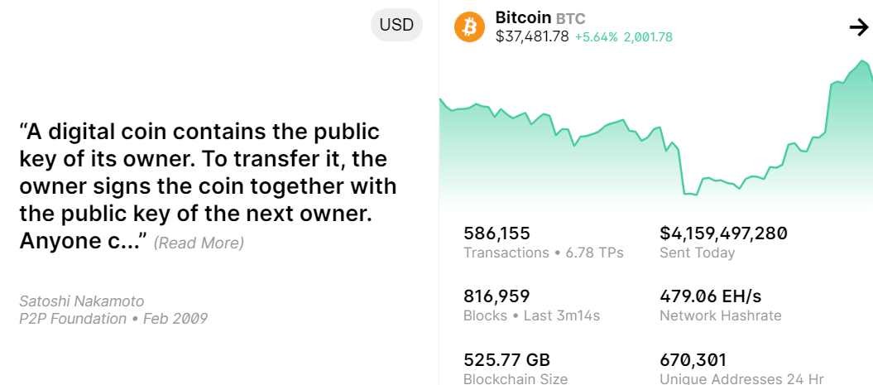
Where is it: in blockchains
The principle of a blockchain: a distributed peer-to-peer data resource. Each block contains the hash value of the previous block.
Cryptocurrencies: The blocks in the blockchain contain transactions.
As of 2023, Forbes estimates that there are about 26 000 different cryptocurrencies. Bitcoin is probably the best known.
https://www.blockchain.com/explorer

Slide 11
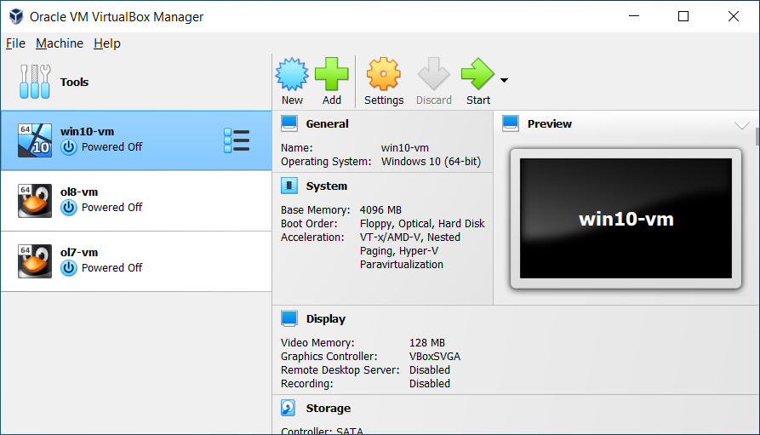
Where is it: in the cloud
Cloud computing refers to the delivery of computing services over the internet, providing access to resources like servers, storage, databases, networking, and software on-demand, without the need for direct management of physical infrastructure (Wikipedia, Cloud Computing).
In the 1990’s some companies started calling virtualized services (like running a virtual machine) “the cloud”. In the picture: running a VM in a computer.
In 2006 Amazon started providing a cloud computing system (virtual machines)
and a storage system.
Cloud service models: IaaS/SaaS/PaaS.

Slide 12
Bonus: In the “dark web”
“The dark web” is a term used for web pages that are not reachable by normal browsers. This does not mean password protected sites. It means that the routing (see your network course notes) is done by software like TOR (the onion router). Therefore the access method of reaching those sites is different from accessing normal (“surface web”) sites.
Example of a dark web site (it’s a search engine but don’t try to open).
http://juhanurmihxlp77nkq76byazcldy2hlmovfu2epvl5ankdibsot4csyd.onion/
Estim number of TOR sites: 65 000
Estim number of users: 2.5 million.
https://earthweb.com/how-many-people-use-the-dark-web/

